Slide 1



Project on Amazon Sales
By – Pragathi B Shetty

Slide 2

DATASET OVERVIEW :
Sales management has gained importance to meet increasing competition and the need for improved methods of distribution to reduce cost and to increase profits. Sales management today is the most important function in a commercial and business enterprise. Do ETL: Extract-Transform-Load some Amazon dataset and find for me Sales-trend -> month-wise, year-wise, yearly month-wise.
Tools Used
Microsoft Excel
Microsoft Power BI

Slide 3
DATASET FEATURES :
Unit Solid
Unit Price
Unit Cost
Total Revenue
Total Cost
Total Profit
Region
Country
Item Type
Sales Channel
Order Priority
Order Date
Order ID
Ship Date

Slide 4
KEY METRICS
Sum of Total Cost
93.18M
Sum of Unit Cost
19.10K
Sum of Total Revenue
137.35M
Sum of Unit Sold
513K
Sum of Total Profit
44.17M
Sum of Unit Price
27.68K

Slide 5



93.18M
Sum of Total Cost
Power BI Desktop
Sales Channel

All

Total Profit by Region
Total Revenue by Item Type
Item Type by Country
37M
Cosmetics
Office Supplies Household Baby Food Clothes
Cereal Meat
Personal Care Vegetables Beverages Snacks
Fruits
Clothes
Cosmetics Office Supp… Fruits Personal Care Household Beverages Baby Food Cereal Vegetables Snacks
Meat
31M
Sub-Sahara… Europe
Asia
Middle East… Australia an… Central Am… North Amer…
1.46M (3.3%)
30M
2
6 (6%) (2%)
7 (7…)
7
(7%)
12.18M (27.58%)
10M
13 (13%)
13
(13%)
4.72M (10.69%)
8M
Item Type
5M
5M
4M
5.76M (13.…)
8
(8%)
9 (9%)
10 (10%)
3M
12
(12%)
10 (10%)
6.11M (13.84%)
11.08M (25.09%)
3M
2M
0M
40M
20M
Total Revenue
0M
27.68K
Sum of Unit Price
19.10K
Sum of Unit Cost
513K
Sum of Units Sold
137.35M
Sum of Total Revenue
44.17M
Sum of Total Profit

Slide 6
FINDINGS:
Profit by Top 6 Countries:
Pakistan – 3.44M
Switzerland
Honduras – 2.9M
Mexico
Rwanda – 2.83M
Myanmar
Top 3 Item Type by Country of Profit:
Beverages
Cosmetics
Office Supplies

Slide 7
FINDINGS:
ONLINE
OFFLINE
SUM OF TOTAL COST | 39.01M | SUM OF TOTAL COST | 54.17M
SUM OF TOTAL REVENUE | 58.25M | SUM OF TOTAL REVENUE | 79.09M
SUM OF TOTAL PROFIT | 19.25M | SUM OF TOTAL PROFIT | 24.92M
SUM OF UNIT PRICE | 12.14K | SUM OF UNIT PRICE | 15.54K
SUM OF UNIT COST | 8.26K | SUM OF UNIT COST | 10.84K
SUM OF UNIT SOLD | 236K | SUM OF UNIT SOLD | 277K

Slide 8







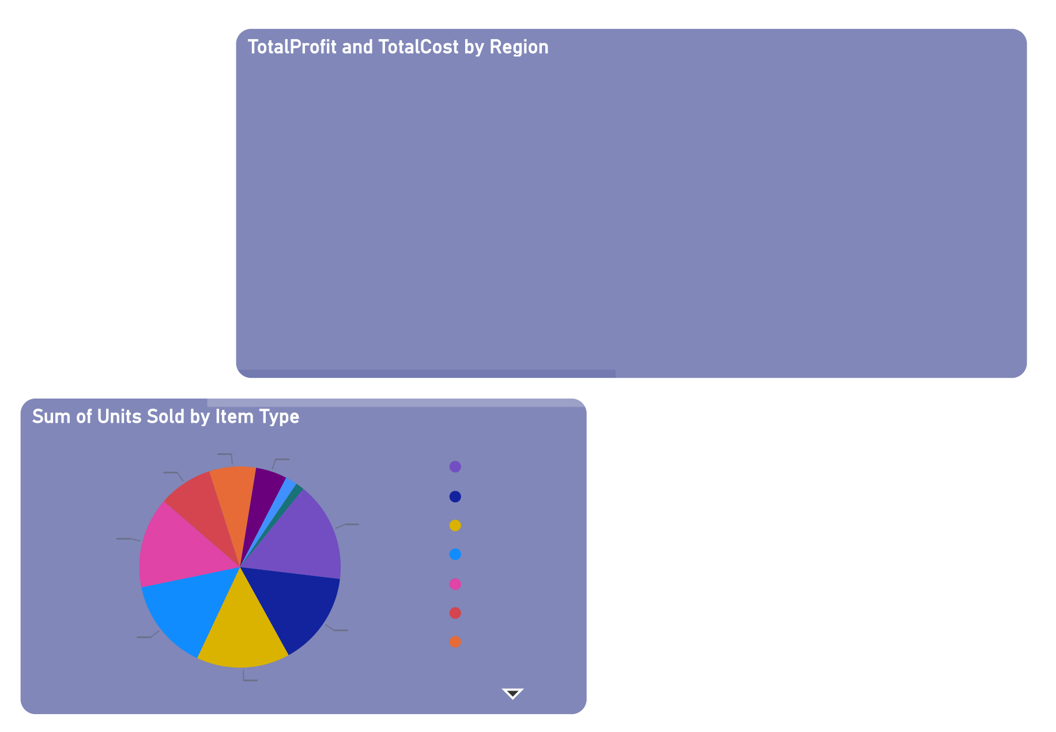
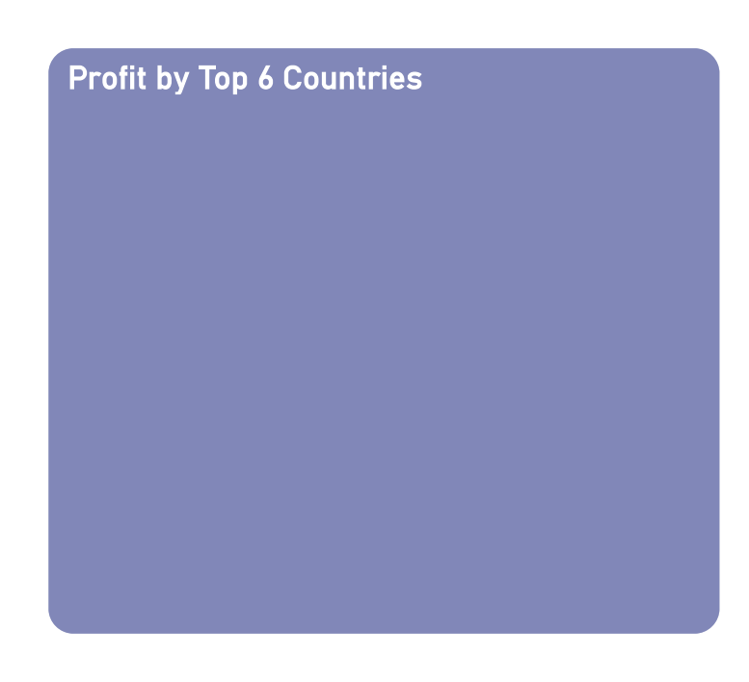

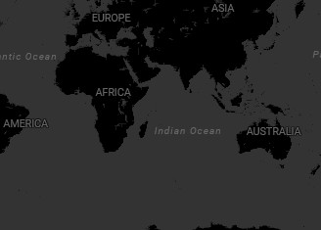
Power BI Desktop
Asia
Australia and Oceania
Central America and…
Europe
Middle East and Nort…
North America
Sub-Saharan Africa
TotalProfit and TotalCost
15M
18.0M
12.5M
10M
7.8M
8.6M
5.6M
5.8M
2.5M
4.2M
1.5M
TotalProfit TotalCost
Sales Channel

5M
3.6M
2.2M
2.8M
Middle East and North Africa
1.9M
2.3M
Australia and Oceania
Offline
0M
Sub-Saha… Africa
Europe
Asia
Central America and the Caribbean
Region
North America
Online
© 2024 Miiccrrossofftt Corrporrattiion
Net Profit
Item Type
Household
Cosmetics Beverages Clothes
Personal Care Baby Food Office Supplies
NetProfit
TotalCost
TotalProfit
2M
RankbyProfit
4M
7.51%
5.02%
8.71%
3.44M
2.97M
2.83M
14.58%
16.06%
1M
2M
0M
14.77%
15.08%
0M
Pakistan
Honduras
Mexico
Rwanda
Myanmar
15.03%
-1M
Switzerland
1/16/2011
1/11/2012
11/19/2016

Slide 9
Findings
OffLINE :
The top 3 total revenue categories by item type are office supplies, cosmetics, and household goods. Thus, the top three nations are The Gambia, Sierra Leone, and Mexico. Asia, Europe, and Sub-Saharan Africa are the top three regions with that. The top 6 nations in terms of Net profit between 16/1/2011 and 19/11/2016 are Pakistan, Switzerland, Honduras, Mexico, Rwanda, and Myanmar. The graphs show a downward trend for total profit and total cost by region in sub-Saharan Africa and an upward trend for North America, with all seven areas shown offline.
OnLINE:
By kind of goods, cereal, office supplies, and cosmetics make up the top three overall revenue categories. Thus, Azerbaijan, Bulgaria, and Djibouti are the top three countries. From October 27, 2015, to January 14, 2017, Net profit increased without declining. Samoa, Iceland, Azerbaijan, Romania, Djibouti, and Iran are therefore the top six nations.

Slide 10
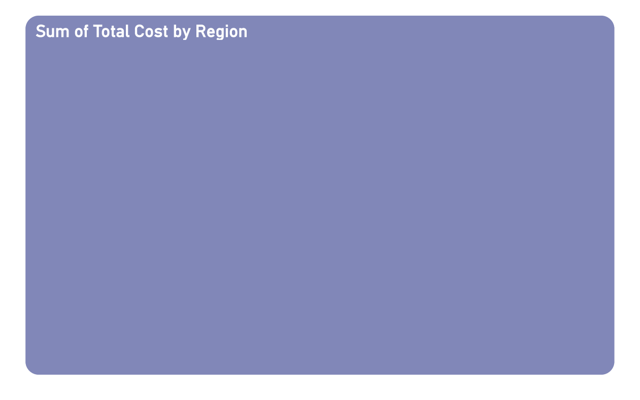

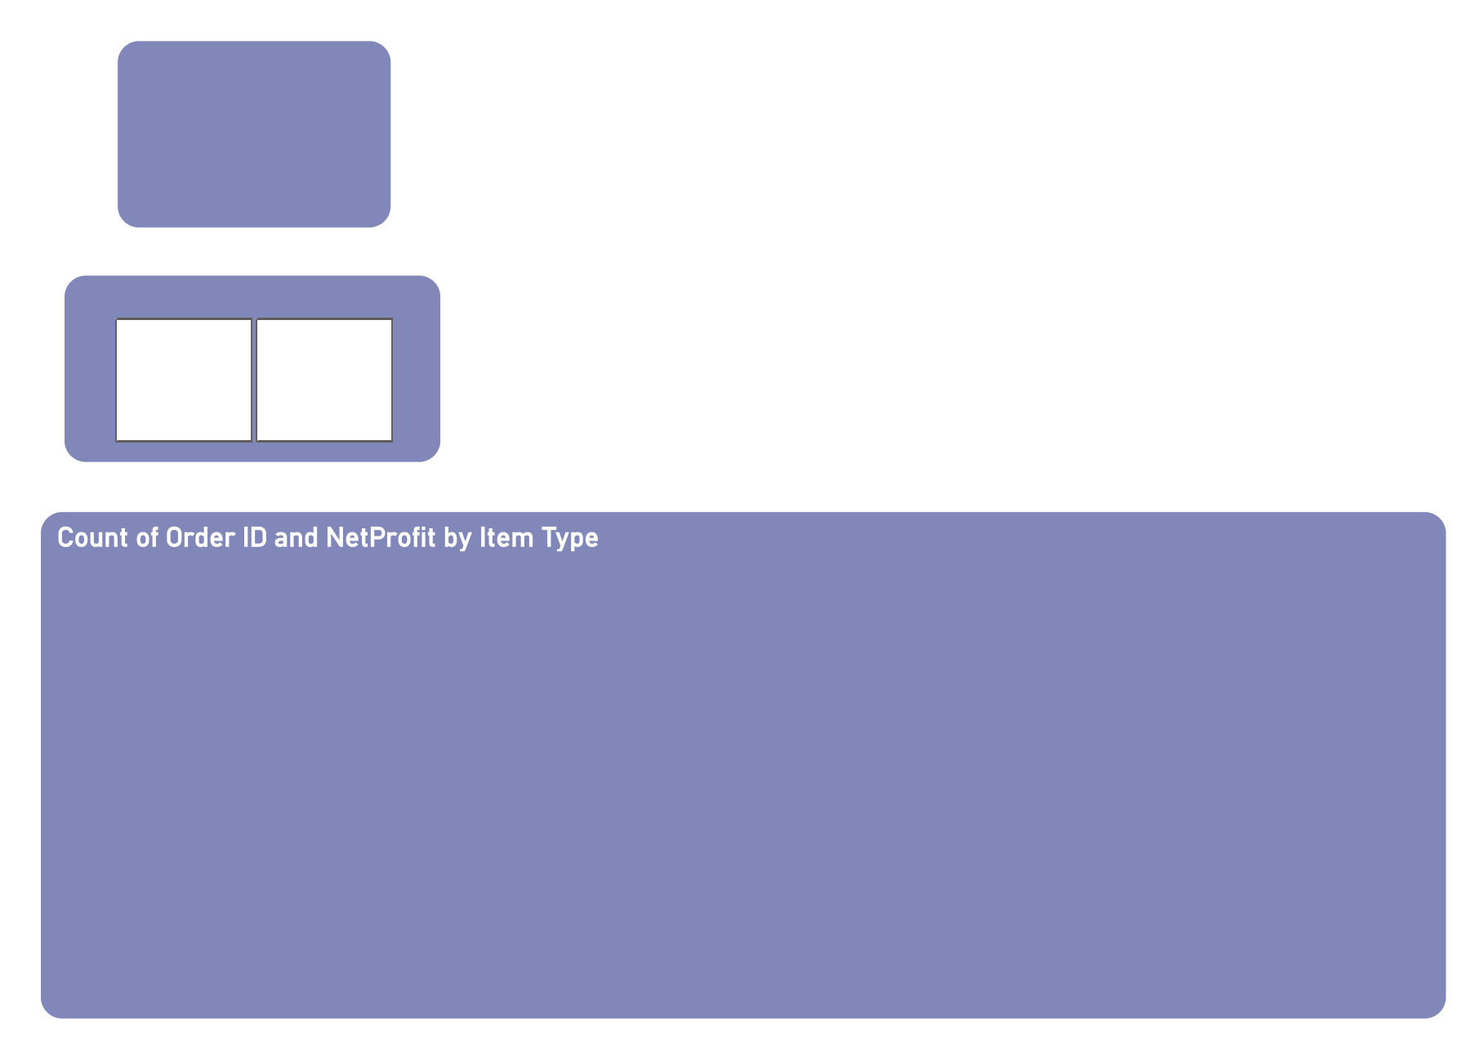
Power BI Desktop
Country  | TotalProfit
Total | 4,41,68,198.40
Zambia | 2,25,246.90
United Kingdom | 46,735.86
Tuvalu | 9,51,410.50
Turkmenistan | 12,67,258.40
The Gambia | 13,85,883.27
Syria | 9,119.44
Switzerland | 15,12,729.45
Sri Lanka | 12,08,744.24
Spain | 7,47,939.49
South Sudan | 53,252.50
Solomon Islands | 2,85,087.64
Slovenia | 72,975.60
Slovakia | 10,795.23
Sierra Leone | 6,49,879.30
Senegal | 5,84,073.87
Saudi Arabia | 3,59,941.17
Sao Tome and Principe | 1,76,193.13
San Marino | 4,55,335.00
Samoa | 16,78,540.98
Rwanda | 14,17,493.49
Russia | 2,24,598.75
Romania | 13,75,311.70
Republic of the Congo | 1,52,114.20
Portugal | 1,22,029.78
Pakistan | 17,19,922.04
Norway | 7,94,398.84
Niger | 75,555.90
Nicaragua | 1,27,722.96
New Zealand | 5,270.67
Myanmar | 18,02,771.70
Mozambique | 8,89,472.91
Mongolia | 1,22,819.06
Monaco | 8 25 738 04
100%
Sub-Saharan Africa
27.49M
100
Count of Order ID
Europe
22.29M
Asia
15.23M
Australia and Oceania
Middle East and North Africa
9.37M
8.29M
Sales Channel

Central America and the Ca…
6.32M
Offline
Online
North America
4.19M
15.2%
50% 2679376 100.00%
0%
-50%
-18726213 -100.00%
-7489412 -100.00% -225491 -100.00%
-15064501 -100.00% -2577040 -100.00%
-914700 -100.00%
-3282456 -100.00%
-557418 -100.00%
-100%
Clothes
Cosmetics
Office Supplies
Fruits
Personal Care
Household
Beverages
Baby Food
Cereal
Vegetables
Snacks
Meat

Slide 11
THANK YOU

